Slide 1
Backtracking

Slide 2
Introduction
systematic method for searching for one or more solutions for a given problem
A backtracking design paradigm can solve
Enumeration problems All solutions are listed for a given problem.
Decision problems A solution is given in terms of yes/no.
Optimization problems optimal solutions are required to maximize or minimize the given objective function as per the given problem’s constraints
Effectively solve multi-decision problems, where the final solution is visualized as a set of decisions.
Can find the first possible solution or looks for all possible solutions for the given problem. Eg: Torchlight search, puzzles (mazes, Sudoku)

Slide 3
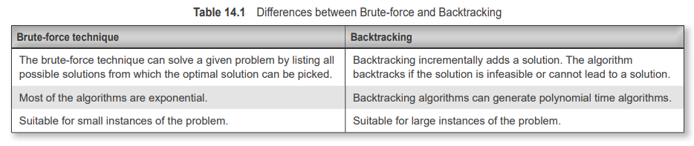
Brute-force vs Backtracking

Slide 4
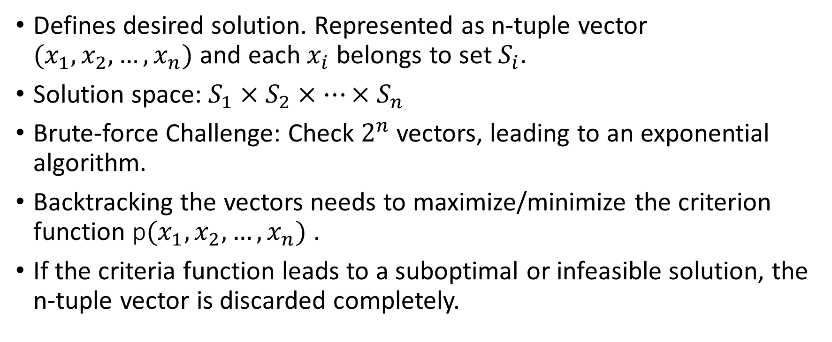
Basics of Backtracking
Defines desired solution. Represented as n-tuple vector $(x_{1},x_{2},…,x_{n})$ and each $x_{i}$ belongs to set $S_{i}.$
Solution space: $S_{1}×S_{2}×…×S_{n}$
Brute-force Challenge: Check $2^{n}$ vectors, leading to an exponential algorithm.
Backtracking the vectors needs to maximize/minimize the criterion function p$(x_{1},x_{2},…,x_{n})$ .
If the criteria function leads to a suboptimal or infeasible solution, the n-tuple vector is discarded completely.

Slide 5

Basics of Backtracking
Two types of constraints:
Explicit constraints.
Implicit constraints.
Explicit constraints are rules that restrict components of the solution vector, say $x_{i}$ from a set $S$. For example $x_{i}$≥0 is an explicit constraint as $x_{i}$ is forced to a value greater than zero.
Implicit constraints are rules that limit n-tuple vectors $(x_{1},x_{2},…,x_{n})$. All the vectors in the solution space may not satisfy the criteria function. Internal constraints force only those n-tuple vectors that are promising.
Example: 8-Queen Problem

Slide 6
Generations of state space trees
Arranges all possible solutions in a tree-like fashion.
The other names for state-space tree are solution space or recursion tree.
Everybranch is a variable, and every level represents a solution. Every node represents a partial solution that illustrates the choices made from the root to that node, and the edges represent the transition from states.
If the problem has a solution, then the solution is present in a node somewhere in the state-space tree.
Thus, the problem is reduced to searching for this node, the solution node, from the root of the state-space tree

Slide 7
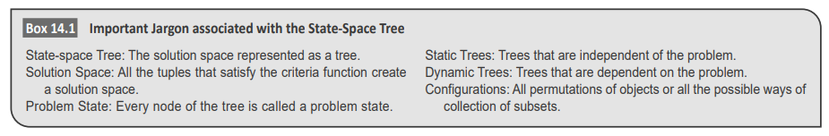
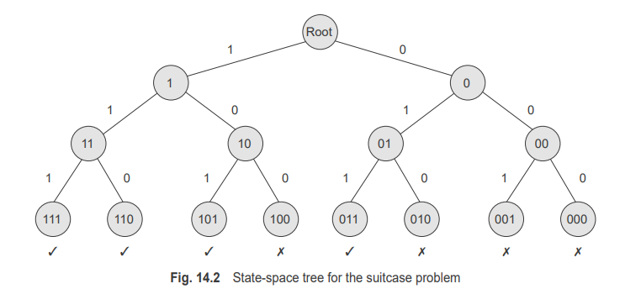
Generations of state space trees
Consider a suitcase password problem, where a three-digit password of a suitcase is forgotten. Assume
that the digits of the password are restricted to binary numbers, and the unknown password is said to have at least two 1s. Construct a backtracking solution for this problem.

Slide 8
Searching state-space tree
Step 1: While many choices are left out, perform Step 2.
Step 2: Generate a state-space tree using the DFS approach.
2a:Check the next configurations using bounding functions
2b: if the solution is promising, then
if the solution is obtained, then
print the solution
else
Backtrack to the parent of the node and try again
Step 3: End.

Slide 9
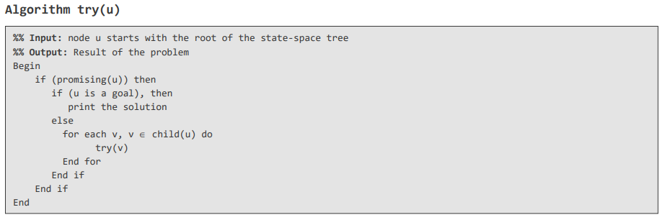
Backtracking algorithm

Slide 10
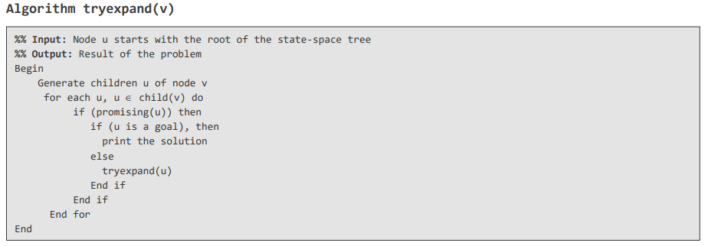
Modified version of Backtracking Algorithm
The difference between the previous algorithm and this algorithm is that the children node would be visited only if the node is promising

Slide 11
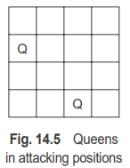
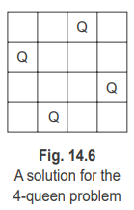
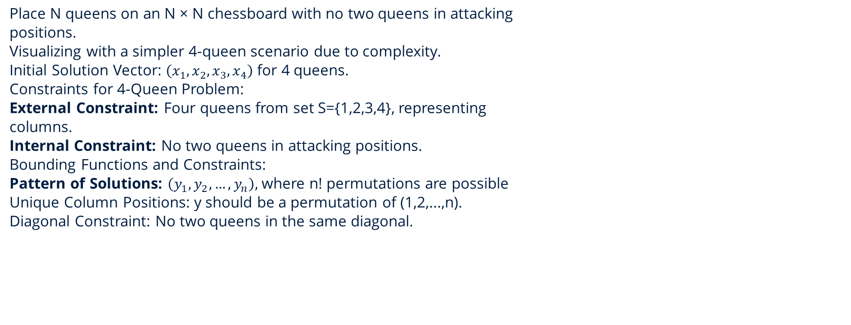
N-Queen Problem
Place N queens on an N × N chessboard with no two queens in attacking
positions.
Visualizing with a simpler 4-queen scenario due to complexity.
Initial Solution Vector: $\left(x_{1},x_{2},x_{3},x_{4}\right)$ for 4 queens.
Constraints for 4-Queen Problem:
External Constraint: Four queens from set S={1,2,3,4}, representing
columns.
Internal Constraint: No two queens in attacking positions.
Bounding Functions and Constraints:
Pattern of Solutions: $\left(y_{1},y_{2},…,y_{n}\right),$ where n! permutations are possible
Unique Column Positions: y should be a permutation of (1,2,...,n).
Diagonal Constraint: No two queens in the same diagonal.

Slide 12
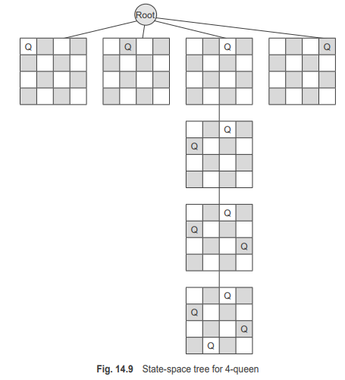
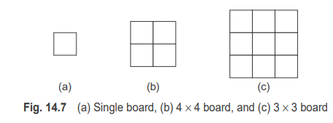
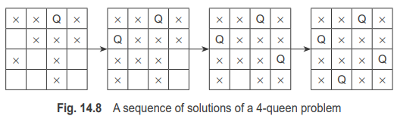
N-Queen Problem
Given 1 × 1, 2 × 2, 3 × 3, and 4 × 4 boards, show the placement of queens in these boards

Slide 13
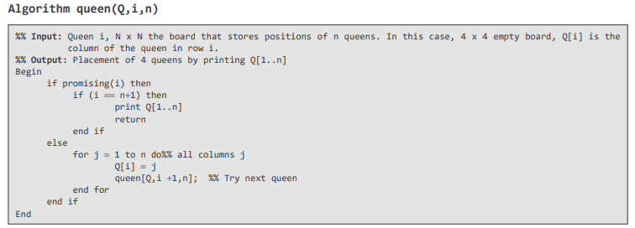
N-Queen Problem Algorithm

Slide 14
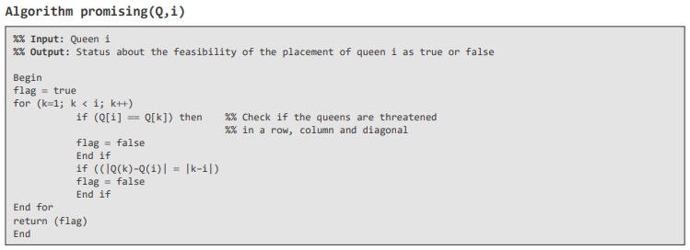
N-Queen Problem promising Algorithm

Slide 15
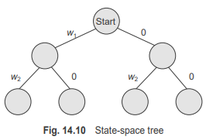
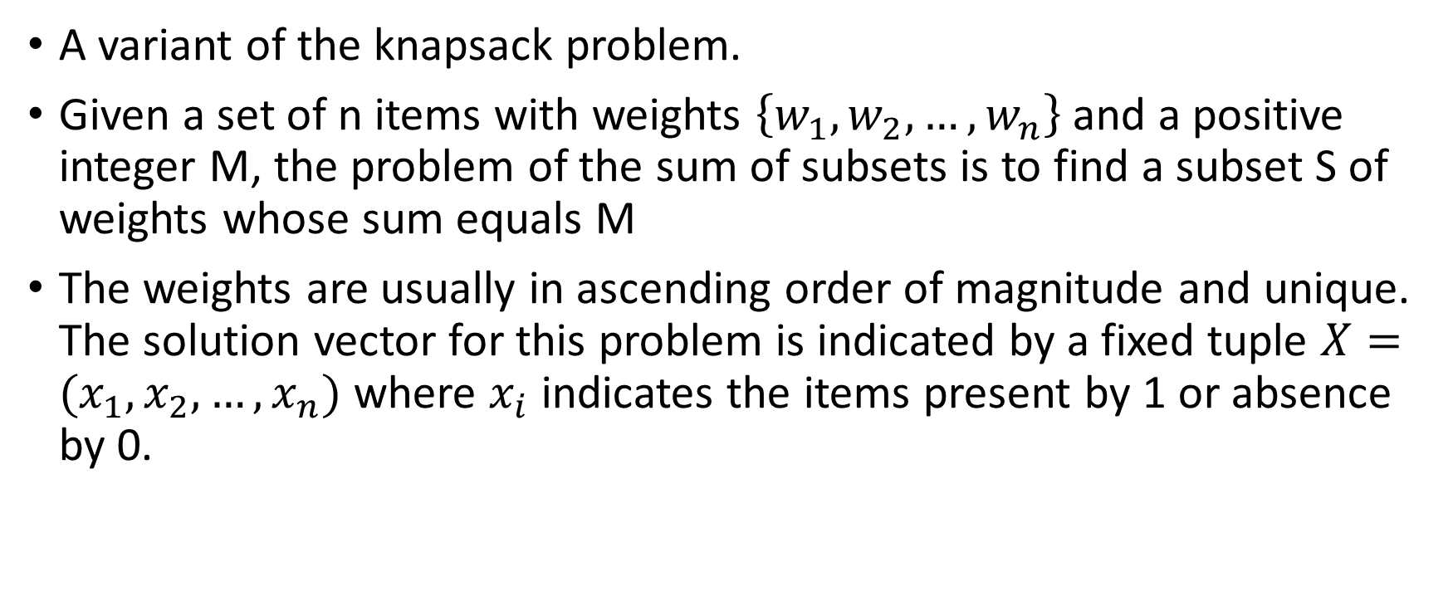
Sum of subsets problem
A variant of the knapsack problem.
Given a set of n items with weights $\left\{w_{1},w_{2},…,w_{n}\right\}$ and a positive integer M, the problem of the sum of subsets is to find a subset S of weights whose sum equals M
The weights are usually in ascending order of magnitude and unique. The solution vector for this problem is indicated by a fixed tuple $X=(x_{1},x_{2},…,x_{n})$ where $x_{i}$ indicates the items present by 1 or absence by 0.

Slide 16
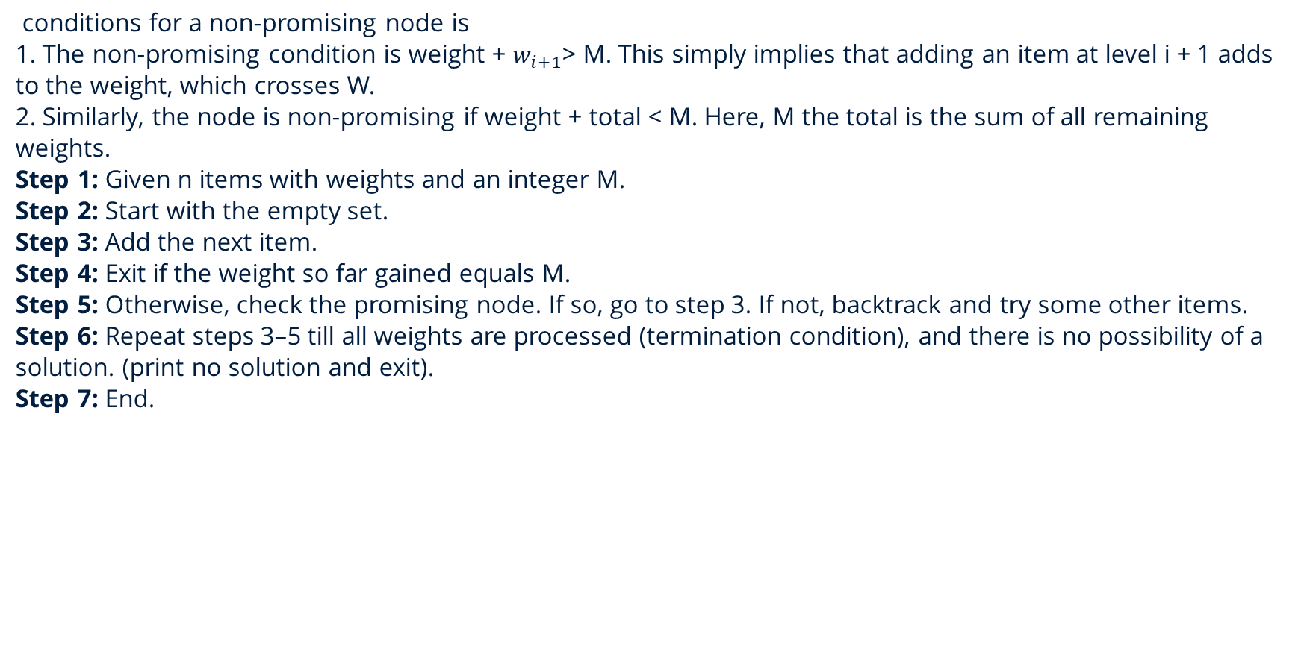
Sum of subsets problem
conditions for a non-promising node is
1. The non-promising condition is weight + $w_{i+1}$> M. This simply implies that adding an item at level i + 1 adds to the weight, which crosses W.
2. Similarly, the node is non-promising if weight + total < M. Here, M the total is the sum of all remaining weights.
Step 1: Given n items with weights and an integer M.
Step 2: Start with the empty set.
Step 3: Add the next item.
Step 4: Exit if the weight so far gained equals M.
Step 5: Otherwise, check the promising node. If so, go to step 3. If not, backtrack and try some other items.
Step 6: Repeat steps 3–5 till all weights are processed (termination condition), and there is no possibility of a solution. (print no solution and exit).
Step 7: End.

Slide 17
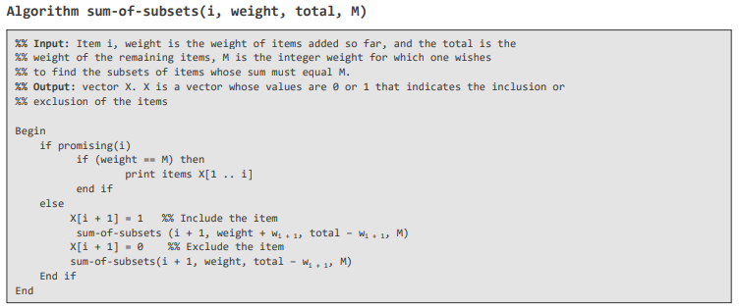
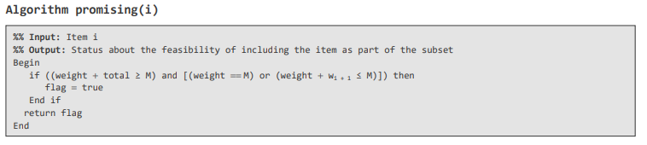
Sum of subsets problem algorithm

Slide 18
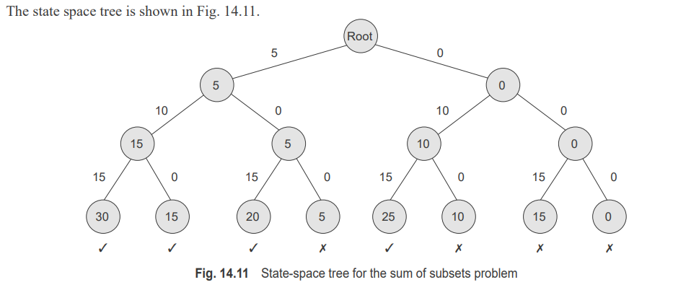
Let us assume that W = [5, 10, 15] and M = 20. What are the different combinations possible? Use the backtracking approach.

Slide 19
Vertex colouring problem or M-Colouring
Step 1: While there are untried configurations of assigning colours to vertices, perform Step 2.
Step 2: Generate the next configuration by assigning arbitrary colours to the vertices, limited to integers M.
2a: Test the assignment of colours to vertices, so that the constraint is not violated. The constraint is that no two adjacent vertices can share the same colour.
2b: If the assignment is promising, report success and break.
2c: Otherwise, backtrack; go to Step 1.
Step 3: End.

Slide 20
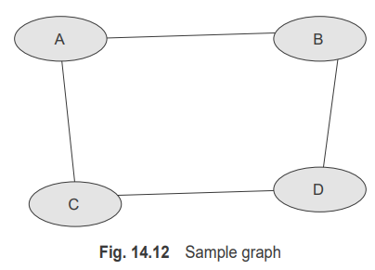
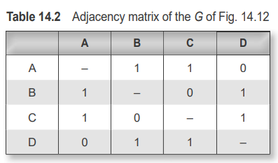
Vertex colouring problem or M-Colouring
Given a graph shown in Fig. 14.12, what is the minimum number of colors required to color the graph?

Slide 21
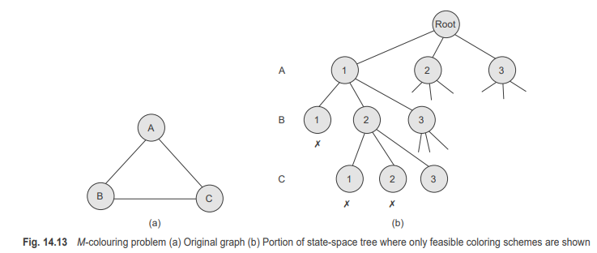
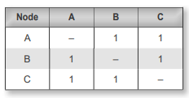
Vertex colouring problem or M-Colouring

Slide 22
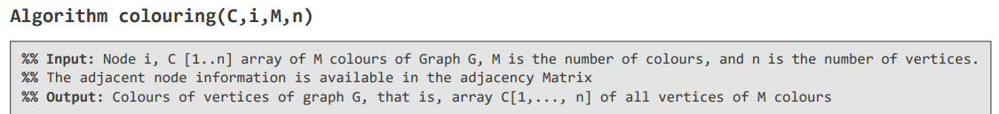
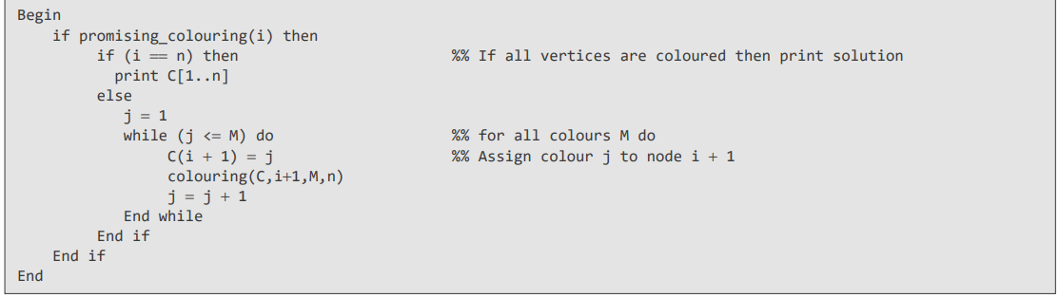
Vertex colouring problem Algorithm

Slide 23
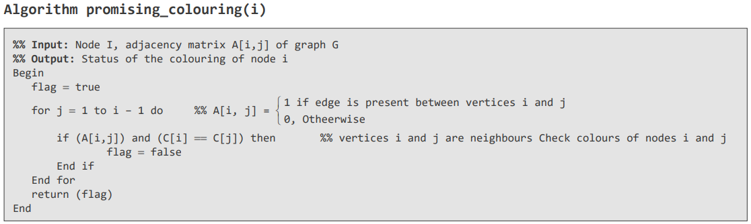
Vertex colouring problem promising Algorithm

Slide 24
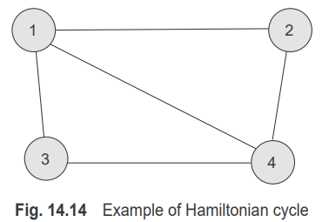
Hamiltonian Circuit Problem
The Hamiltonian problem involves checking if a Hamiltonian cycle is present in a given graph G or not.
The graph in Fig. 14.14 illustrates the presence of a Hamiltonian graph in G. It can be verified that a Hamiltonian cycle 4-3-1-2-4 exists as shown in Fig. 14.14.

Slide 25
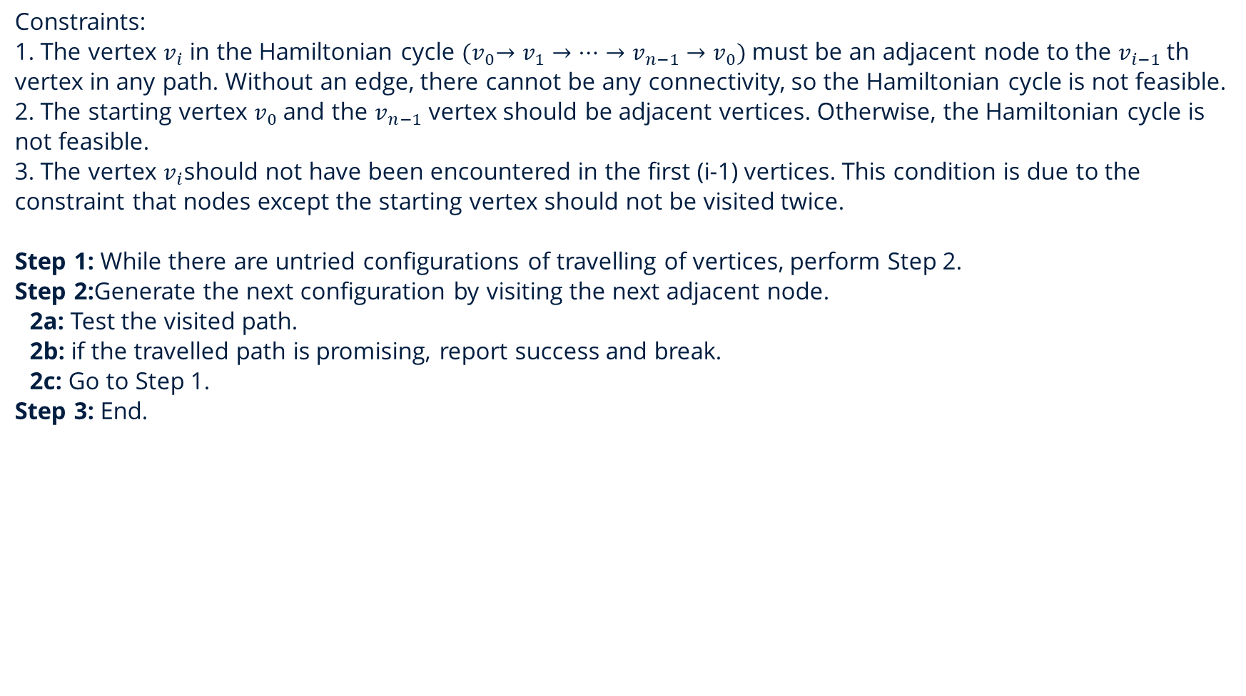
Hamiltonian Circuit Problem
Constraints:
1. The vertex $v_{i}$ in the Hamiltonian cycle ${(v}_{0}→v_{1}→…→v_{n−1}→v_{0})$ must be an adjacent node to the $v_{i−1}$ th vertex in any path. Without an edge, there cannot be any connectivity, so the Hamiltonian cycle is not feasible.
2. The starting vertex $v_{0}$ and the $v_{n−1}$ vertex should be adjacent vertices. Otherwise, the Hamiltonian cycle is not feasible.
3. The vertex $v_{i}$should not have been encountered in the first (i-1) vertices. This condition is due to the constraint that nodes except the starting vertex should not be visited twice.
Step 1: While there are untried configurations of travelling of vertices, perform Step 2.
Step 2:Generate the next configuration by visiting the next adjacent node.
2a: Test the visited path.
2b: if the travelled path is promising, report success and break.
2c: Go to Step 1.
Step 3: End.

Slide 26
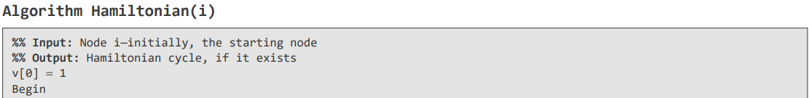
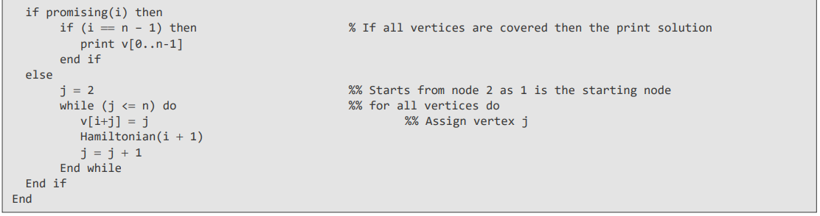
Hamiltonian Circuit Problem Agorithm

Slide 27
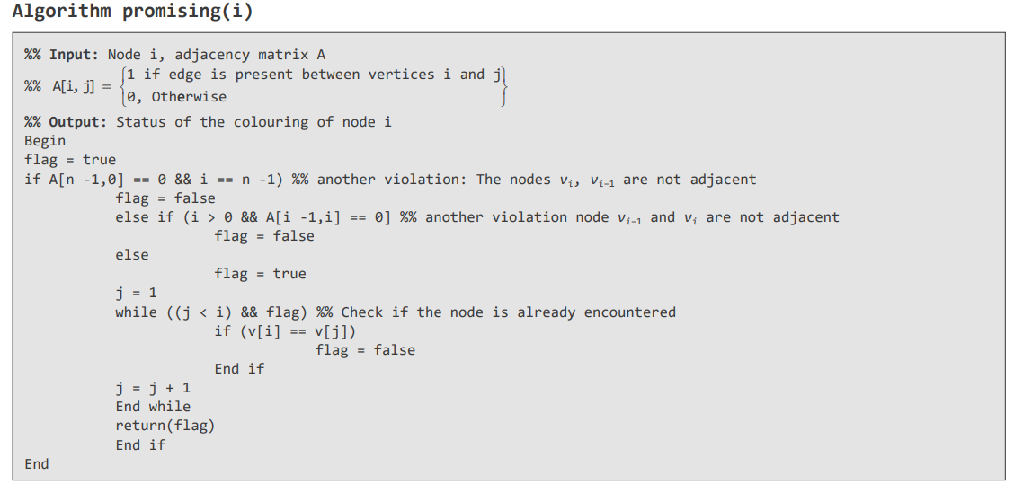
Hamiltonian Circuit Problem Agorithm

Slide 28
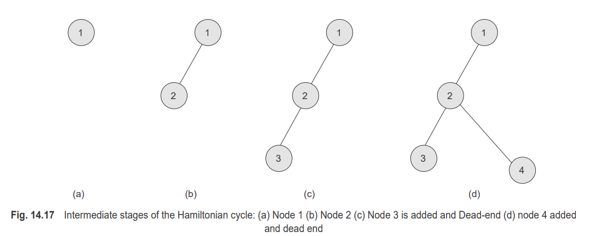
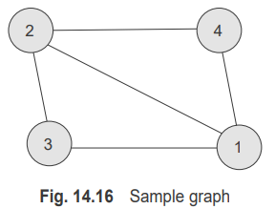
Hamiltonian Circuit Problem
Consider the graph in Fig. 14.16 and show a Hamiltonian cycle

Slide 29
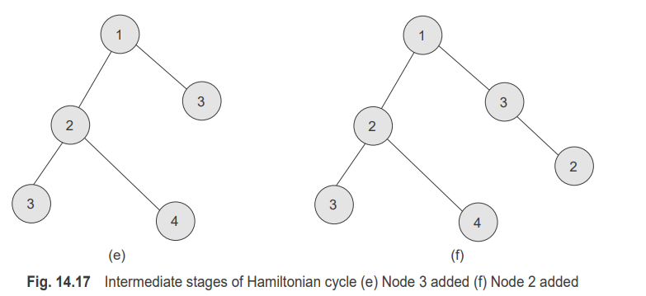
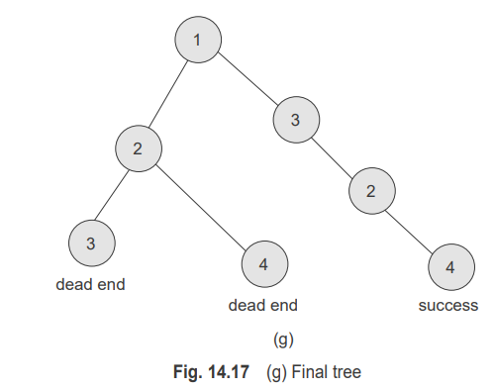
Hamiltonian Circuit Problem

Slide 30
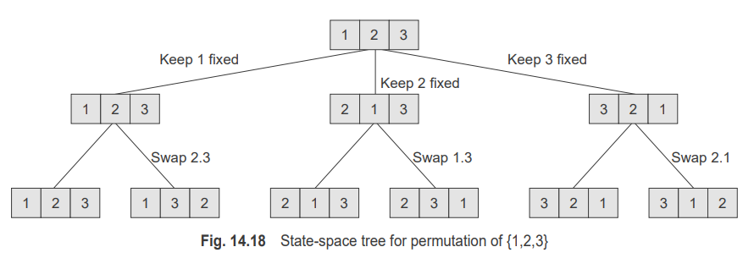
Generating Permutations
A permutation is a method of obtaining all possible arrangements of N items. For N elements, N! permutations are possible. One can recollect that permutations should be distinct.
Step 1: While there are untried configurations of permutations, perform Step 2.
Step 2: Generate the next permutation by adding an element.
2a: Test the generated permutation.
2b: Report success and break if the generated permutation is correct.
2c: Otherwise, backtrack and go to Step 1.
Step 3: End.

Slide 31
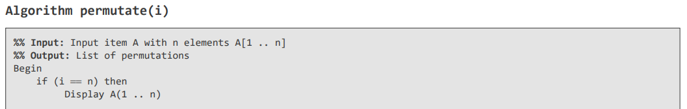
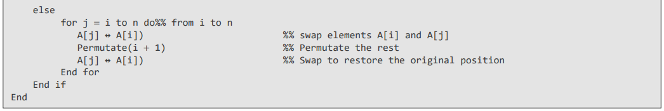
Generating Permutations Algorithm

Slide 32
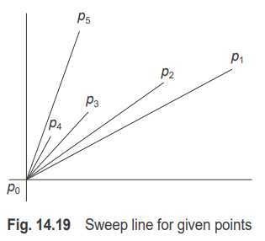
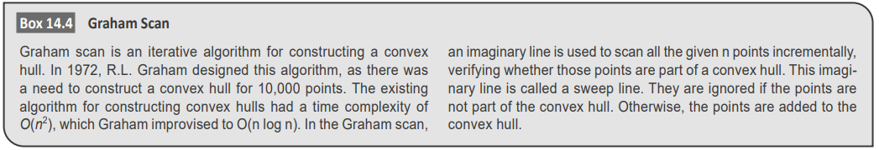
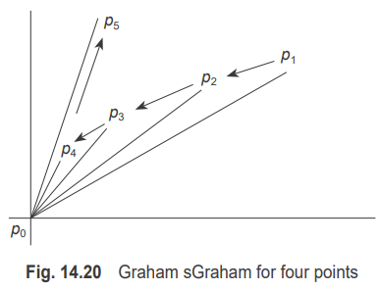
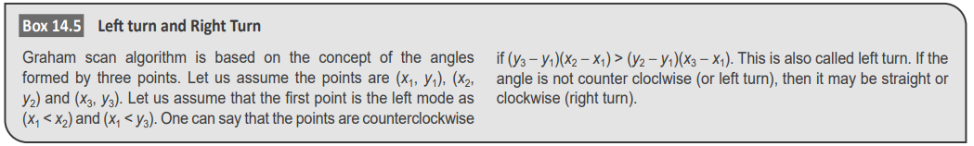
Graham Scan

Slide 33
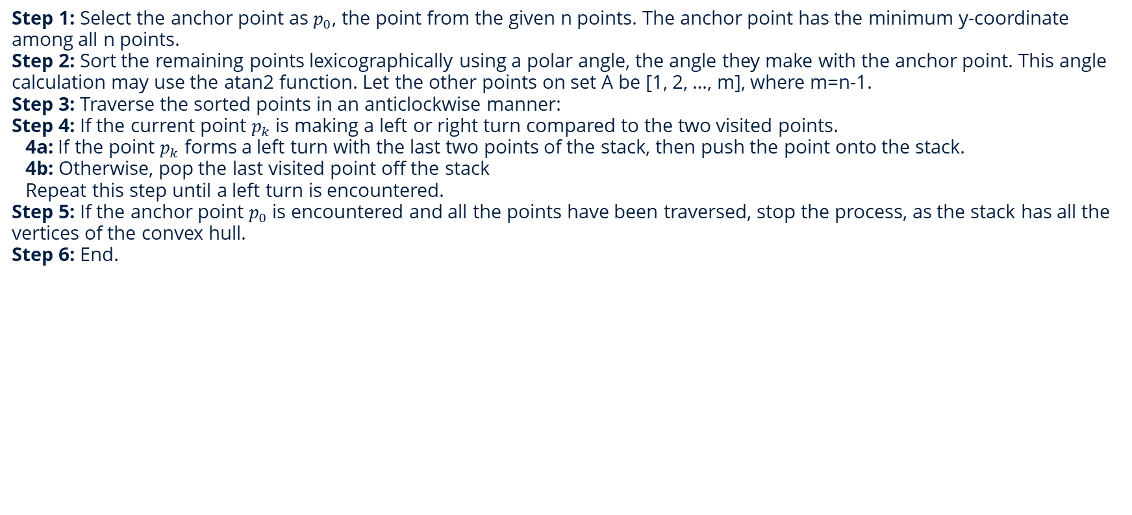
Graham Scan
Step 1: Select the anchor point as $p_{0}$, the point from the given n points. The anchor point has the minimum y-coordinate among all n points.
Step 2: Sort the remaining points lexicographically using a polar angle, the angle they make with the anchor point. This angle calculation may use the atan2 function. Let the other points on set A be [1, 2, …, m], where m=n-1.
Step 3: Traverse the sorted points in an anticlockwise manner:
Step 4: If the current point $p_{k}$ is making a left or right turn compared to the two visited points.
4a: If the point $p_{k}$ forms a left turn with the last two points of the stack, then push the point onto the stack.
4b: Otherwise, pop the last visited point off the stack
Repeat this step until a left turn is encountered.
Step 5: If the anchor point $p_{0}$ is encountered and all the points have been traversed, stop the process, as the stack has all the vertices of the convex hull.
Step 6: End.

Slide 34
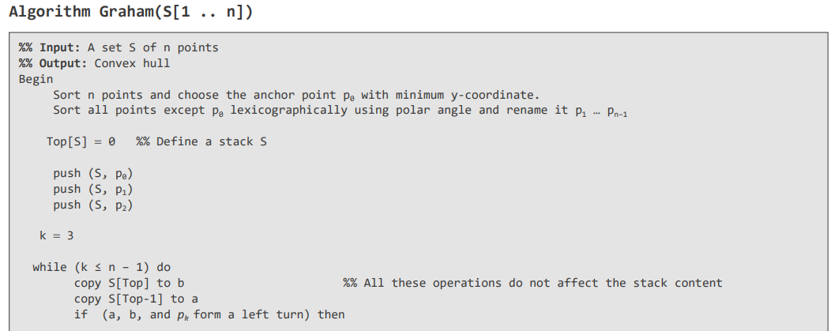
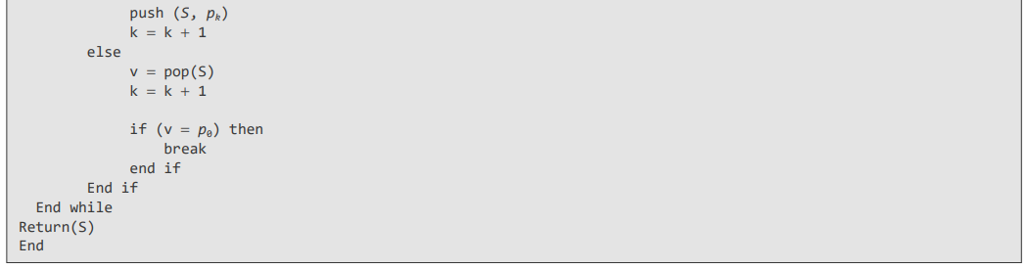
Graham Scan algorithm

